Slide 1
In the name of GOD

Slide 2
Episode 1: Molecular imaging
By : ALI khorramdust
(studing on phd course)

Slide 3
What is molecular imaging?
-molecular imaging is a technique that uses sophisticated diagnostic
Imaging equipment and systems to visualize specific “signal molecules”
1)Imaging sciences have made remarkable advance in technology
2)The understanding of the human genome
3)THE development of animal models of human disease
http://mips.stanford.edu

Slide 4
Which diseases is molecular imaging best posed to address?
-Molecular imaging techniques are well suited for the evaluation of response to
Therapy in cancer.
-Be able to image patients who are at risk.
-It provides the means for clinicians to interpret and relate these changes to disease progression.
http://mips.stanford.edu

Slide 5
What imaging devices perform molecular imaging?
-many imaging techniques are appropriate for molecular imaging.
-PET/CT: Positron emission tomography/computed tomography.
-SPECT/CT: single-photon emission computed tomography/computed tomography
-MRI; magnetic resonance imaging.
http://mips.stanford.edu

Slide 6
What are the biggest challenges for molecular imaging?
-I see three significant challenges in the field.
1)Limitation to “see” enough of the targeted cells inside one cubic millimeter.
2)Relates to challenges of standardization and education…
3)Will need to prove itself with optimal patient outcomes
-CZT: cadmium zinc telluride
Hell SW.2003.Nat.Biotecbnol.21:1347-55
Tsien RY.2005 FEBS Lett.579:927-932
http://mips.stanford.edu

Slide 7
What advice do we have for hospitals or healthcare
Facilities that want to do molecular imaging?
-Molecular imaging is really at the interface of translational medicine.
-Link molecular diagnostics and molecular therapy.
-It possible to locate and treat disease earlier.
http:/www.answers.com

Slide 8
What special knowledge should a healthcare professional
acquire to prepare for a world with molecular imaging?
-A cross specialty training including all new molecular imaging modalities
Will be necessary.
-EMR: electronic medical record
http://www.answers.com

Slide 9
What is the next big breakthrough expected in molecular imaging?
-Besides the new opportunities in PET and SPECT already discussed.
http://mips.stanford.edu

Slide 10
Fluorescence Molecular Imaging

Slide 11
There is a wealth of new flouresent reporter technologies for tagging
Of many cellular and subcellular processes in vivo
Annu.rev.biomed.eng.2006.8:1-7

Slide 12
The macroscopic observation of a patient has been the major mean of medical diagnosis
The ability to capitalize on a wide range of light-tissue interactions and corresponding
Photophysical and photochemical mechanisms and processes at the molecular level.
That can be used to probe at scales spanning from the molecular to the system level
And yield important insights into biology and research.
Annu.rev.biomed.eng.2006.8:7-12

Slide 13
In recent years, fluorescence microscopy and imaging have received
Particular attention.
There is an increasing list of fluorescent imaging techniques that offer
Microscopic resolutions and video-rate scans.
It has been long known that light can propagate through several centimeters
Of tissue in the far-red and near-infrared(NIR)
Diffusion results in the loss of imaging resolution
Macroscopic fluorescence imaging largely depends on spatially resolving and
Quantifying bulk from specific fluorecent entities reporting on cellular and
Molecular activity.
Annu.rev.biomed.eng.2006.8:10-19

Slide 14
One of the most recent technological evolution has been the development
Of fluorescence tomography for investigations at the whole-animal or tissue
Macroscopic fluorescence imaging can be characterized according to a) the
Flourescent reporter technology employed and b) the imaging technology
Employed.
Annu.rev.biomed.eng.2006.8:20-29

Slide 15
Reporter Technologies:
The two major flourescence reporter strategies are classified as
a)Direct and b)Indirect methods
Direct flourescence imaging:
Active probes: A characteristic to active probes is that they flourescence even if they
Are not bound to the intended target
Activatable probes: are molecules that carry quenched fluorechromes
Flourescence probes target specific cellular and subcellular events.
Gibson AP,Hebden JC,Arridge SR.2005.Recent advances in diffuse optical imaging.pbys.Med.Biol.50:R1-34

Slide 16
Indirect flourescence imaging:
Indirect imaging is a strategy that evolved from corresponding in vitro reporting assays
And is well suited to study gene expression and gene regulation
The transgene encodes for a flouresent protein(FP)
Cells can be stably transfected to express FP and report on their position for cell
Trafficking studies.
Different reporter gene strategies have been reported for other imaging modalities
such as PET or MRI
Better constrast can be achieved in the far-red and NIR(≥600nm)
There is a wealth of applications using FPs in developmental biology.
Gibson AP,Hebden JC,Arridge SR.2005.Recent advances in diffuse optical imaging.pbys.Med.Biol.50:R1-34

Slide 17
Planar imaging:
The most common method to record flourescence deeper from tissuses is associated
With illuminating tissue with a plane wave.
Tomographic imaging:
Optical tomography aims at three-dimensinal of the internal distribution of
Fluorochromes or chromophores in tissues based on light measurements collected
At the tissues boundary.
Fluorescence molecular tomography(FMT):
FMT:has evolved as tomographic method combining the theoretical mainframe with
Advanced instrumentation to over come many of limitatioms of planar imaging.
Stephens DJ,Allan VJ.2003.Light microscopy techniques for live cell imaging.science 300:82-86

Slide 18
DISCUSSION

Slide 19
Important new technological advanced in fluorescence imaging and
Tomography come with improved capacity for in vivo microscopic observations.
The wealth of light manipulation and image formation one can achieve often with
Standard off the bench components.
The human breast is relatively transparent to NIR light and high detection sensitivity
Can be optically achieved even when imaging through the breast,conversely,intrinsic
Tumor contrast is not adequate for improving detection over X-ray mammography.
Experimental studies also suggested that volumes as low as 100µl at
Physiologically Relevant fluorochrome concentrations could be detected through
10-12cm through The human breast.
Observations have been further confirmed on realistic breast phantoms.

Slide 20
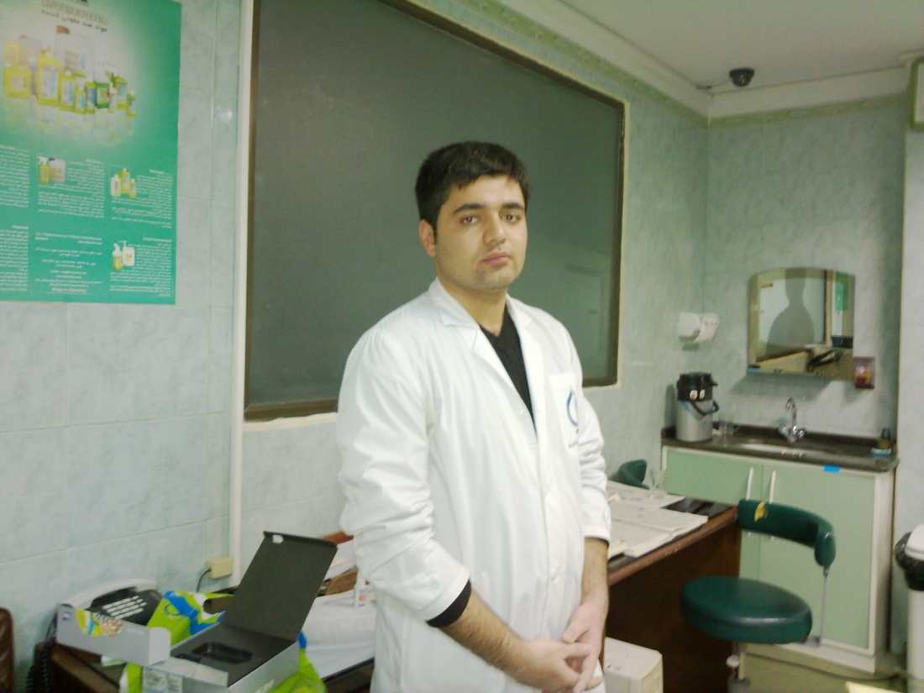
Thank you
Finish episode 1

